Slide 1

Water Quality Modeling and Contaminant Modeling Processes Team Capabilities
UNCLASSIFIED
Jodi Ryder, PhD, Research Civil Engineer
Todd Steissberg, PhD, PE, Research Environmental Engineer
Environmental Laboratory
Engineer Research and Development Center (ERDC)
U.S. Army Corps of Engineers
Water Quality Workshop, 2025
July 16, 2025
UNCLASSIFIED

Slide 2



Objective
Develop an integrated ecohydrology modeling system that simulates heat and nutrient flow through ecosystems.
Water Resources Models
Water Quality Models (Nutrients & Temperature)
Ecological Models

Slide 3
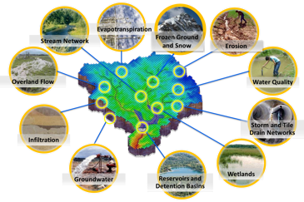
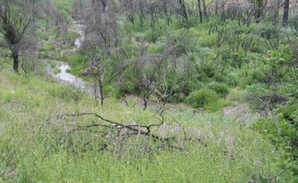
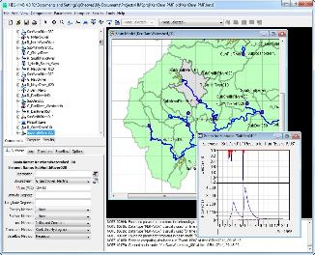
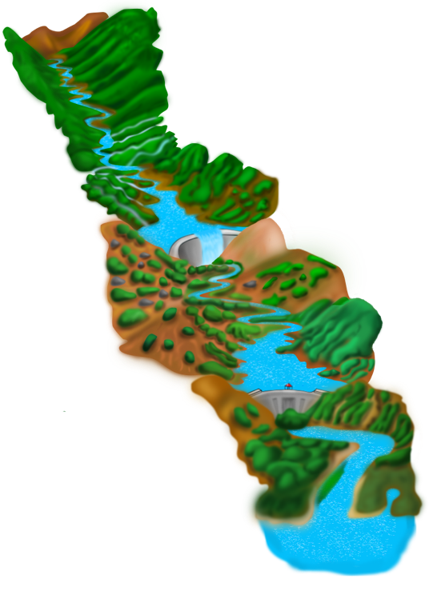
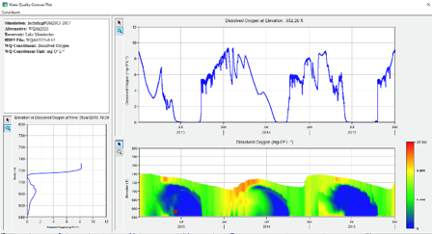
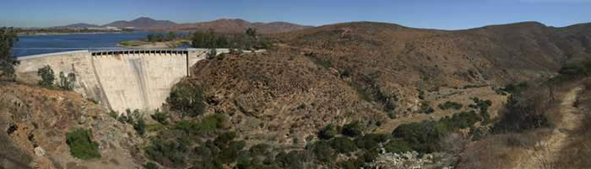
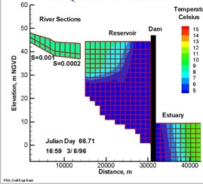
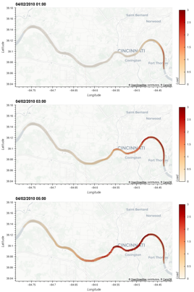
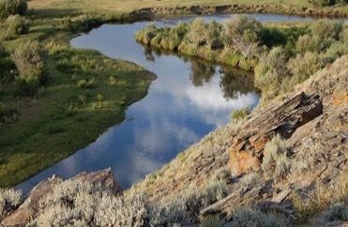
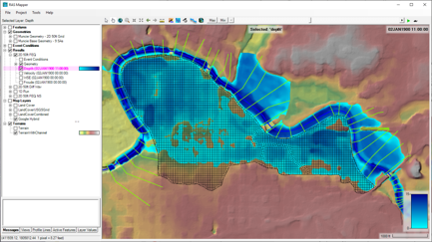
Water Quality and Environmental Systems Modeling
Temperature
Nutrients
Dissolved Oxygen
Algae
Metals
Contaminants
ERDC’s Corps Library for Environmental Analysis and Restoration of Watersheds (ClearWater) provides environmental simulation capabilities that leverage existing hydrologic and hydraulic (H&H) models.
Water quality modeling tools:
Watershed Runoff:
GSSHA: Surface and sub-surface water quality modeling
HEC-HMS: Surface runoff temperature modeling
SWAT: Soil Water Assessment Tool
Reservoirs:
CE-QUAL-W2: 2D reservoir-river hydrodynamics and WQ modeling
HEC-ResSim: Reservoir operations and water quality modeling
Rivers and Floodplains:
HEC-RAS: 1D River hydraulics and WQ modeling
ClearWater-Riverine: 2D River-floodplain hydraulics and water quality modeling with HEC-RAS-2D
Estuary
Key: ERDC-EL – ERDC-CHL – HEC – USDA

Slide 4
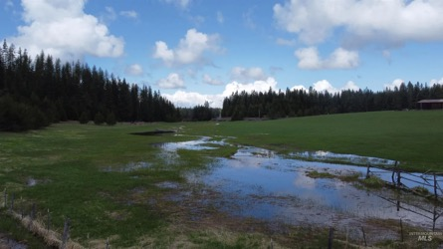
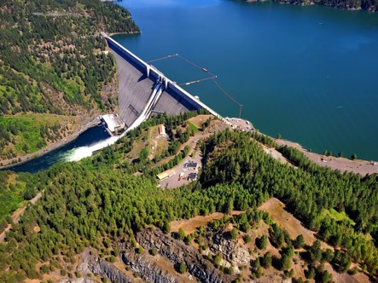
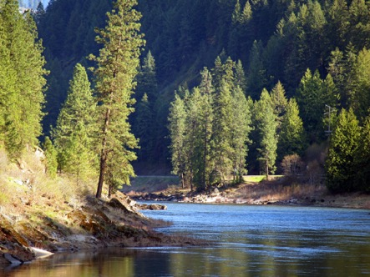
ClearWater: Next Generation Integrated Water Quality Modeling
ClearWater: Corps Library for Environmental Analysis and Restoration of Watersheds
Purpose: Link environmental models with existing water resources models that simulate runoff, rivers, and reservoir hydraulics and hydrology
ClearWater provides environmental simulation capabilities that are designed to leverage existing water resources models.
The ClearWater water quality modules simulate constituent kinetics, heat budget processes, and vegetation growth cycles. Capabilities include:
NSM: Nitrogen, phosphorus, and carbon cycling; dissolved oxygen, algae, etc.
TSM: Temperature (heat budget)
GSM: General Constituents
CSM: Organic and inorganic contaminants
MSM: Mercury
ClearWater contains legacy modules written in Fortran and C++ and next-generation modules written in Python (NSM and TSM)
Engine computes the transport (advection and diffusion) of heat and constituent mass across the watershed
Data visualization capabilities
Framework to integrate multiple models.
Runoff
Reservoirs
Rivers

Slide 5
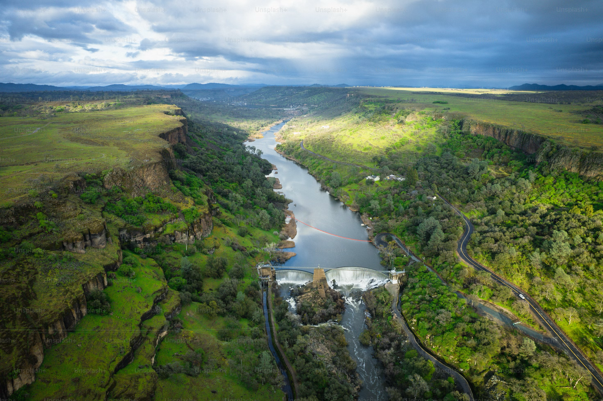
Reservoir Water Quality Modeling

Slide 6
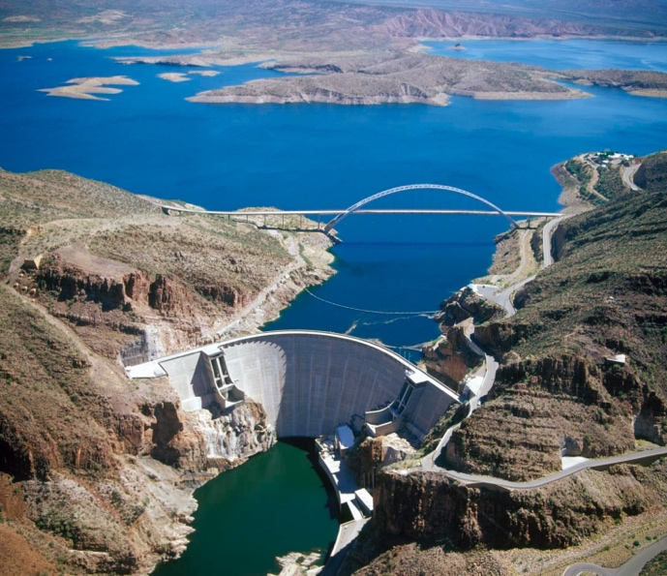
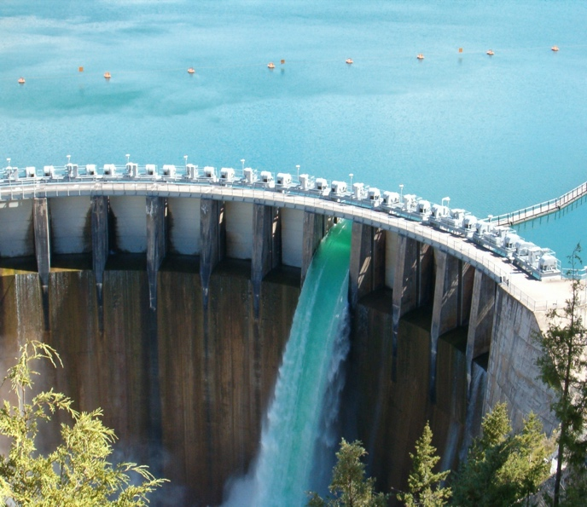
CE-QUAL-W2
CE‐QUAL‐W2 is a two‐dimensional (2D), longitudinal/vertical, hydrodynamics and water quality model. It enables characterization of the vertical and longitudinal changes in a reservoir. The model assumes the reservoir is “well mixed” laterally, with no variation from one side of the channel to the other in a given layer (vertical) and segment (longitudinal).
CE-QUAL-W2 has been applied to rivers, lakes, reservoirs, estuaries, and combinations thereof.
CE-QUAL-W2 incorporates the following water quality capabilities:
Longitudinal-vertical hydrodynamics and water quality in stratified and non-stratified systems
Nutrients-dissolved oxygen-organic matter interactions
Fish habitat
Selective withdrawal from stratified reservoir outlets
Hypolimnetic aeration
Multiple algae, epiphyton/periphyton, zooplankton, and macrophytes
CBOD
Sediment diagenesis model
Generic water quality groups
Internal dynamic pipe/culvert model
Hydraulic structures (weirs, spillways) algorithms, including a dynamic shading algorithm based on topographic and vegetative cover.

Slide 7
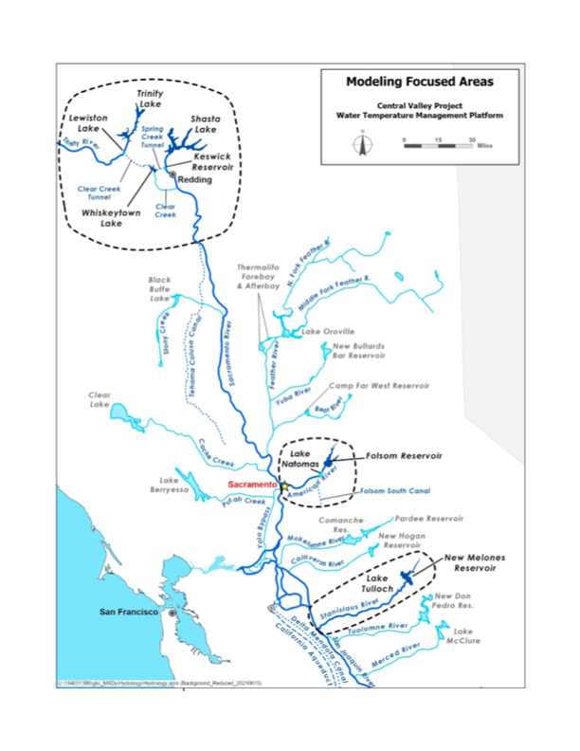
Past and Current Applications of CE-QUAL-W2
CE-QUAL-W2 is widely used by USACE and other federal, state, and local agencies for environmental impact assessments, planning studies, etc. Agencies that use CE-QUAL-W2 as their standard reservoir water quality model include:
U.S. Geological Survey (USGS)
U.S. Bureau of Reclamation
U.S. Environmental Protection Agency (EPA)
State of California
More than 1,100 model applications have been developed worldwide for reservoirs, rivers, estuaries, and other water bodies since CE-QUAL-W2 was released in 1986.
CE-QUAL-W2 is also used as a research tool by researchers at universities and other organizations.
At least 1,500 publications utilized or cited CE-QUAL-W2 in the year 2022 alone.
Recent Studies:
Water Temperature Modeling Platform, California Central Valley Project (USBR and State of California): This platform applies CE-QUAL-W2 for ongoing and future operations decision-making
USACE Northwest Division, Columbia and Snake River Watershed
Columbia System Reservoir Operation (CRSO) Project
Columbia River Treaty (CRT) Project
Philadelphia District, Lehigh River Water Quality Modeling
Region of Application:
Water Temperature Modeling Platform
California Central Valley Project

Slide 8
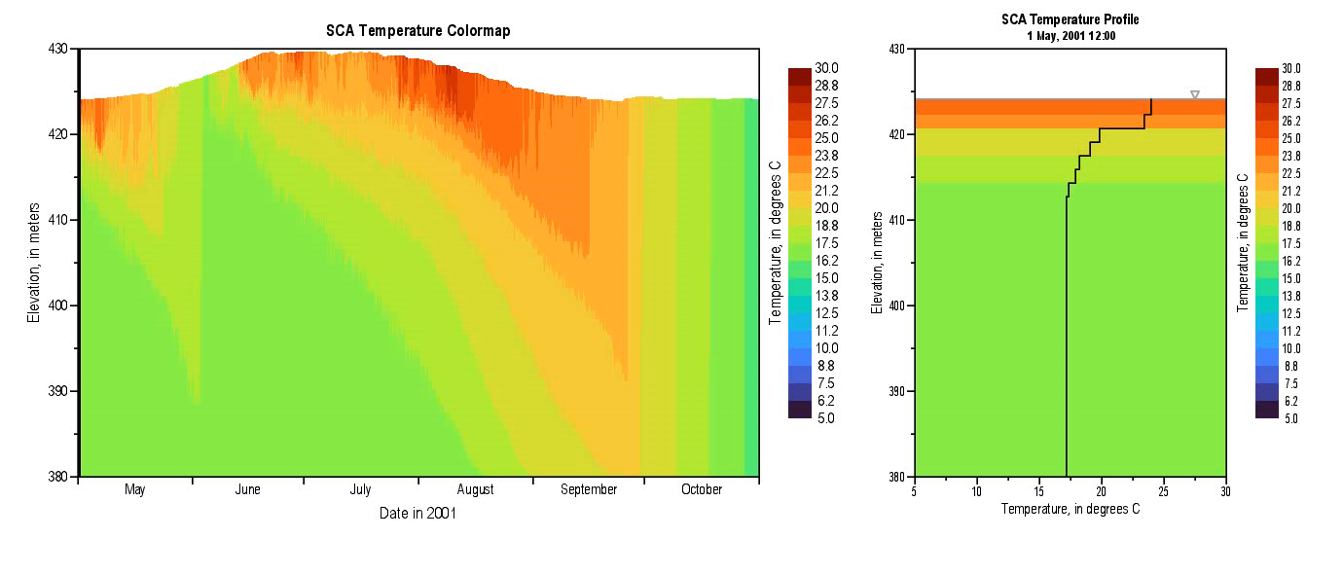
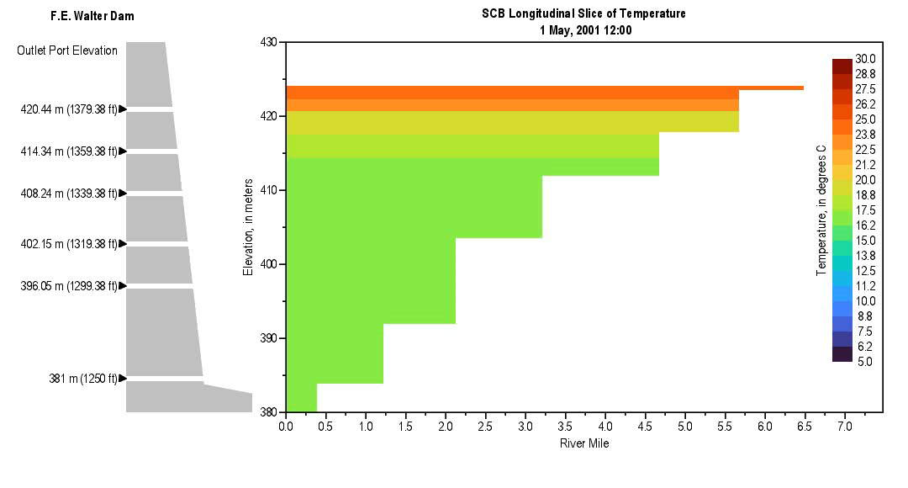
Method and Algorithm Research
Due to excess nutrient loading, warming trends in surface waters, altering hydrologic regimes, and intensifying the stratification of water bodies, Harmful algal blooms (HABs) pose a growing threat to water quality, ecosystem health, and water resource operations.
Four new capabilities were implemented in CE-QUAL-W2 to improve its ability to simulate HABs.
Minimum algae concentration enforcement
Mechanical removal of algae (e.g., harvesting)
High algal mortality under hypoxic conditions
Nitrogen fixation by algae.

Slide 9
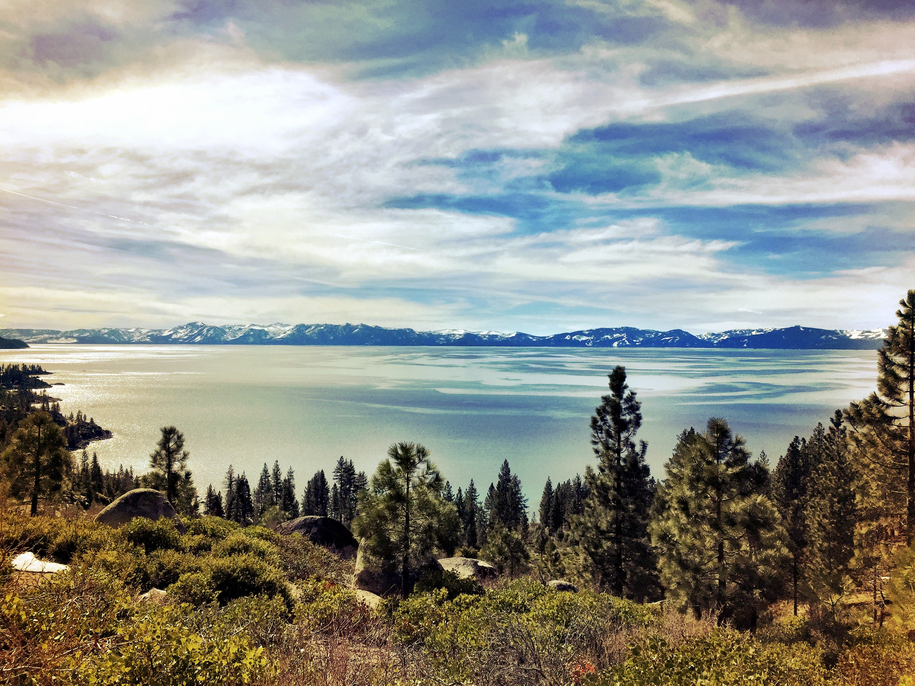
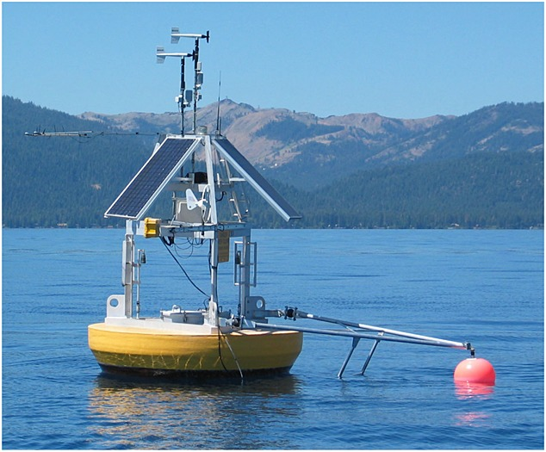
Benefits
With these new capabilities, CE-QUAL-W2 will:
Simulate HAB occurrences with greater precision
Improve understanding of how various environmental factors contribute to HAB dynamics, enabling more proactive management
Generate outputs that will help formulate effective mitigation strategies to reduce the frequency and severity of HAB events by targeting identified key contributing factors
Facilitate adaptive management practices
Improve HAB simulation of multiple future scenarios will improve emergency response and sampling
Improve early detection and management of HABs,which will help protect ecosystem health and public safety, minimizing the adverse effects on wildlife and human populations

Slide 10
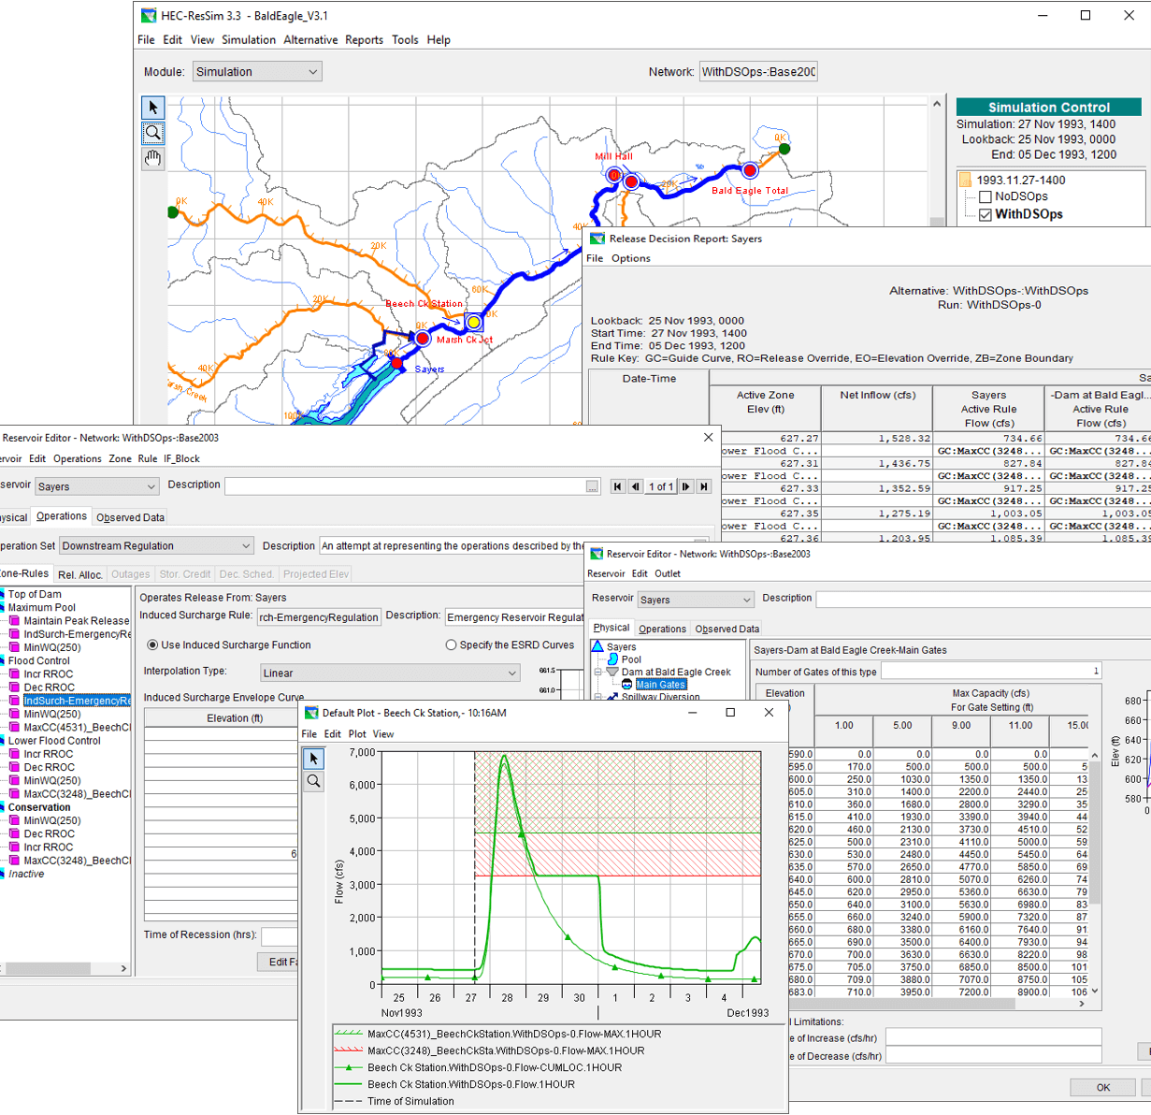
HEC-ResSim Water Quality
HEC-ResSim simulates reservoir operations at one or more reservoirs for:
Flood management
Low flow augmentation
Water supply
Applications:
Planning studies
Detailed reservoir regulation plan investigations
Real-time decision support
Water quality modeling capabilities were developed for HEC-ResSim. These enable:
Water quality and other environmental objectives to directly inform reservoir release decision-making
Watershed-scale ecosystem assessment and management

Slide 11
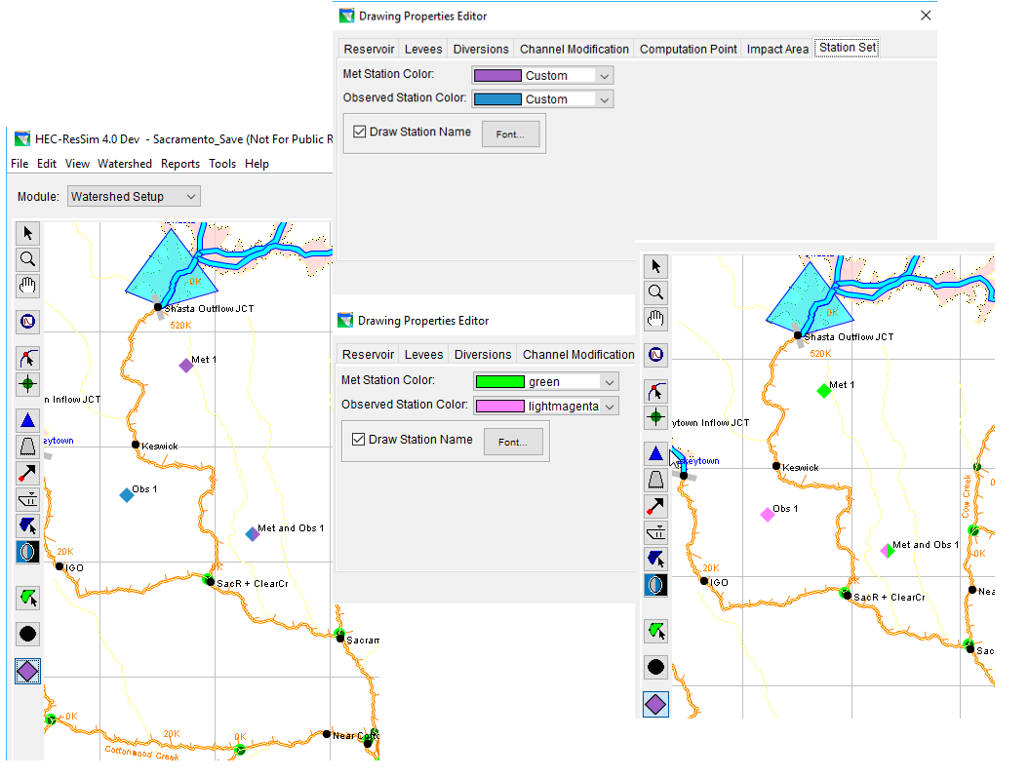
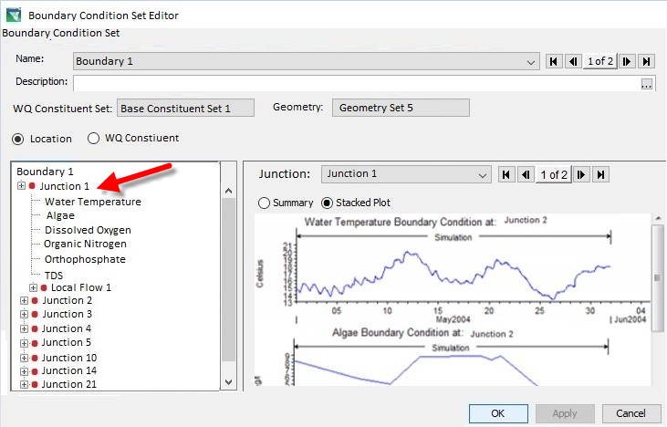
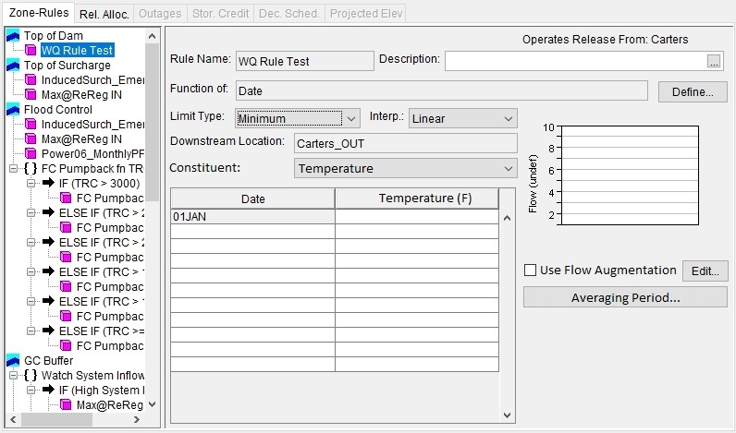
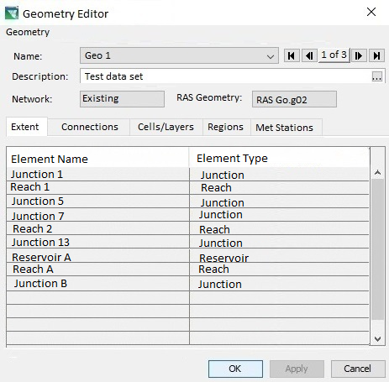
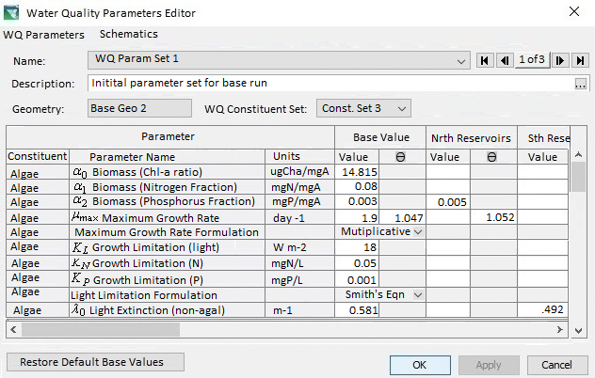
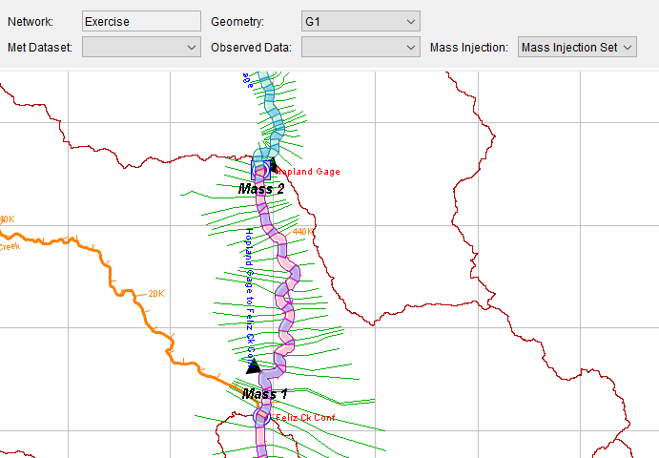
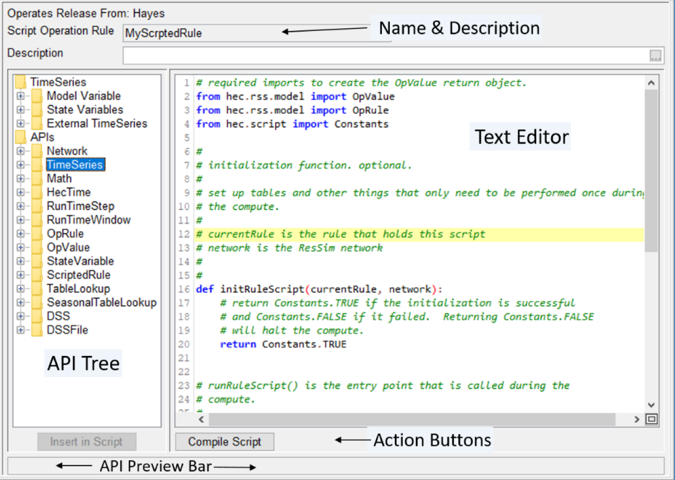
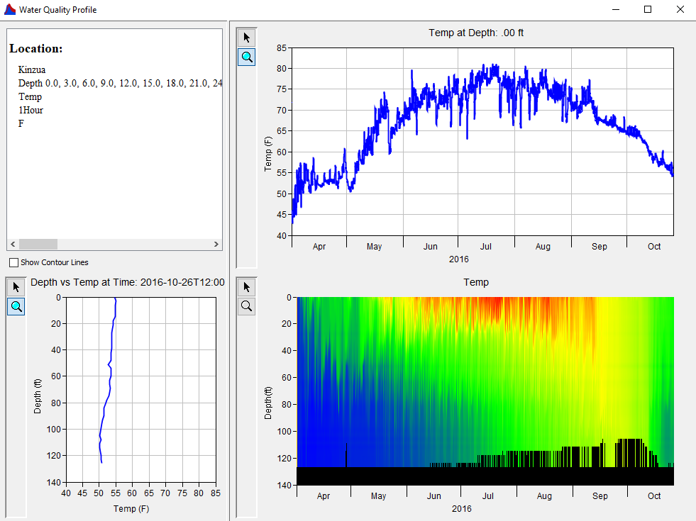
HEC-ResSim Water Quality Modeling User Interface
Model Geometry
Specifying Boundary Conditions
Operating Rule Priorities
Constituent Relation Parameters
Visualization
Scripted Rules and State Variables

Slide 12
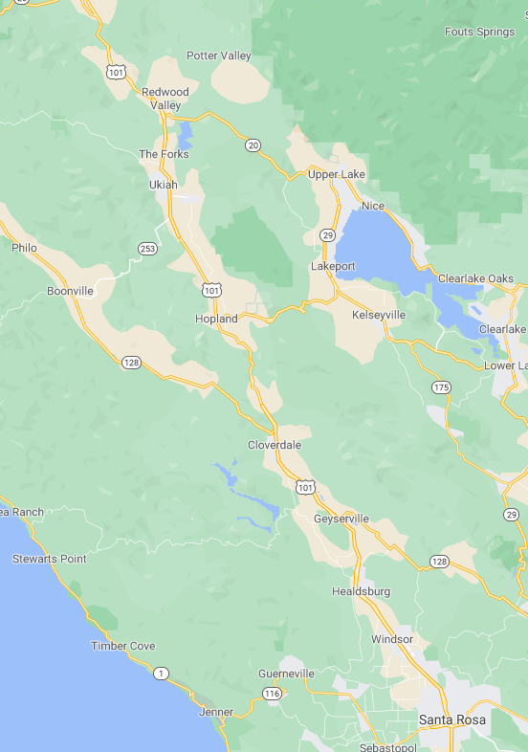
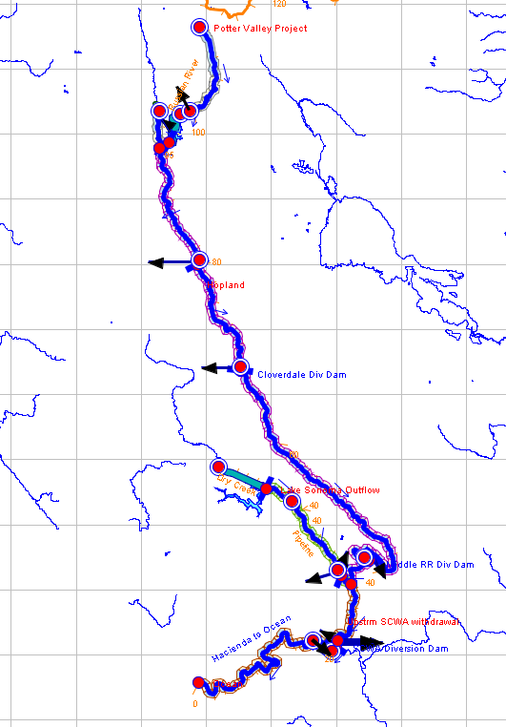
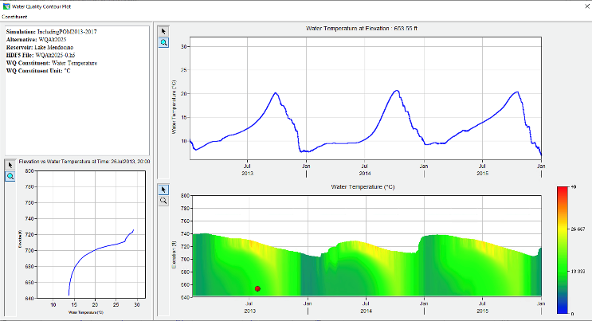

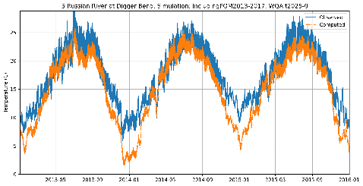
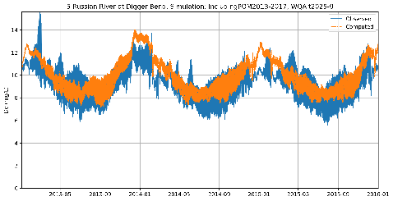
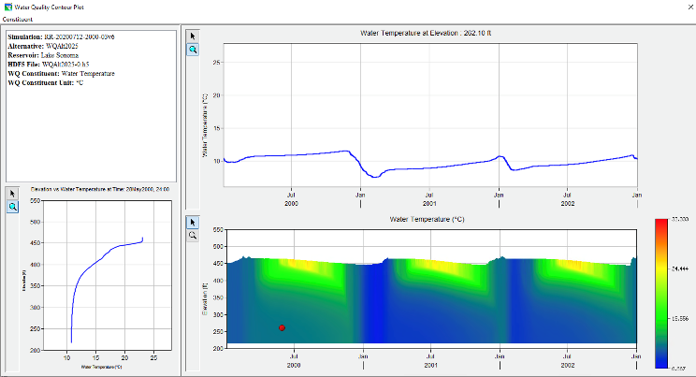
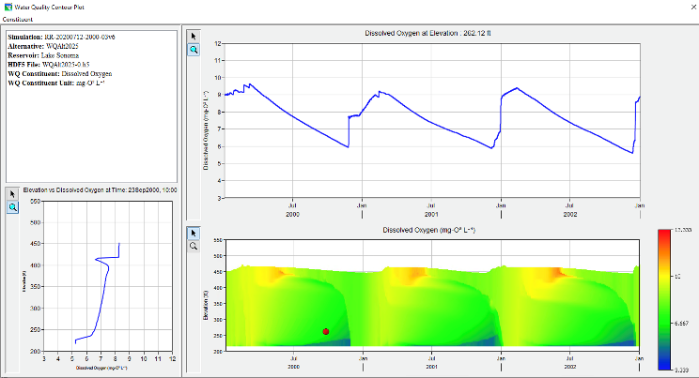
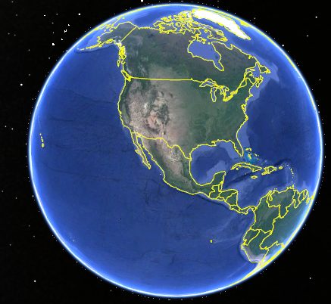
Temperature and Dissolved Oxygen Simulation with HEC-ResSim Russian River, California Prepared by RMA for the Sonoma County Water Agency
Temperature
Dissolved Oxygen
Lake Mendocino
Temperature
Dissolved Oxygen
Lake Sonoma

Slide 13
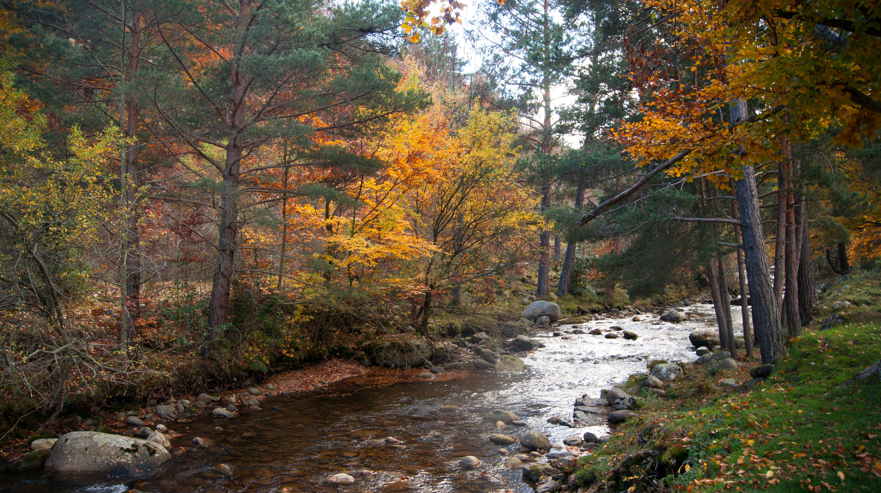
Riverine Water Quality Modeling

Slide 14
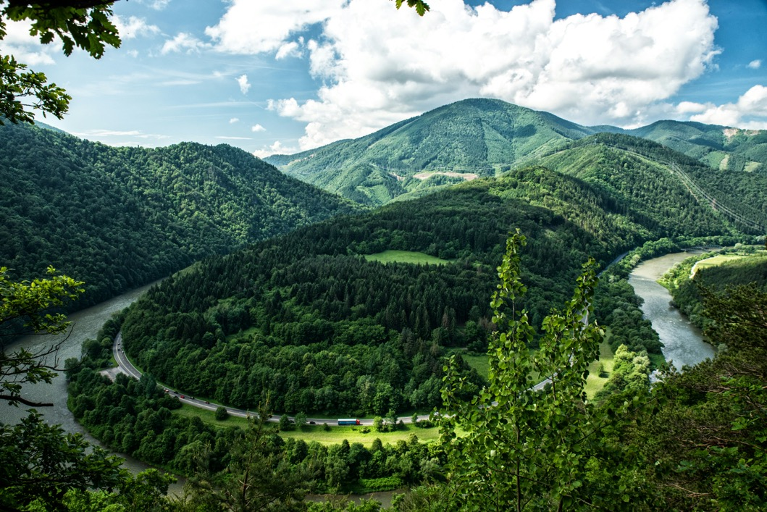

ClearWater-Riverine
Clearwater-Riverine simulates temperature and advanced nutrient cycling in branching river systems and floodplains, incorporating hydrodynamic, water quality, and meteorologic inputs from multiple data sources and models.
Flows: The model grid, volumetric flow, velocities, depths, diffusivity, etc. are provided by existing 2D water resources models.
HEC-RAS (2D)
GSSHA (in progress)
Modules: Water quality kinetics and heat budget simulation capabilities in ClearWater-Riverine are furnished by ERDC's ClearWater modules (e.g., NSM).
Transport: The ClearWater transport engine computes advection-diffusion of heat and mass through the model network.
Framework: The ClearWater framework links all the components together and performs the water quality compute sequence.
Currently design is based on decoupled modeling, i.e., the flows are pre-computed by the hydro models.

Slide 15
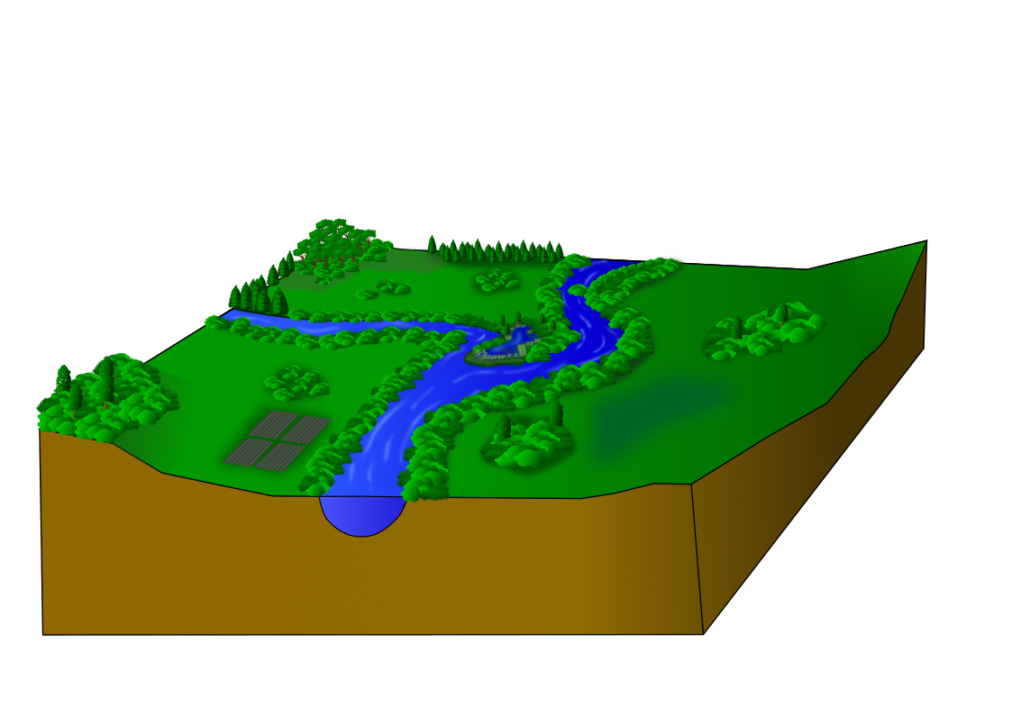
Model Dimensions: River-Floodplain System
Unstratified river channels are often modeled as one-dimensional (1D) water bodies, varying from upstream to downstream
Hydrologic connectivity across the floodplain is important
Floodplains need to be modeled as two-dimensional (2D) water bodies, varying in all directions across the landscape
2D River (Floodplain, Wetlands)
1D River (Channel)
Graphics by Lauren Melendez

Slide 16
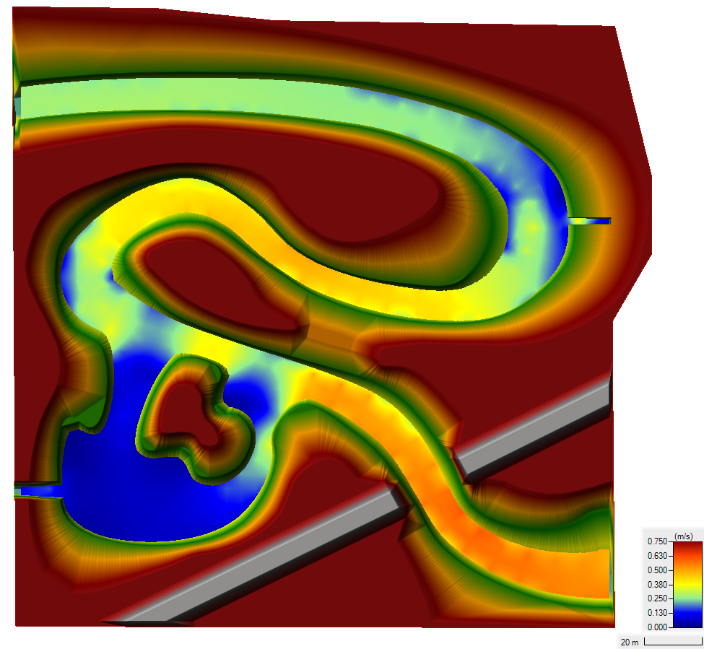
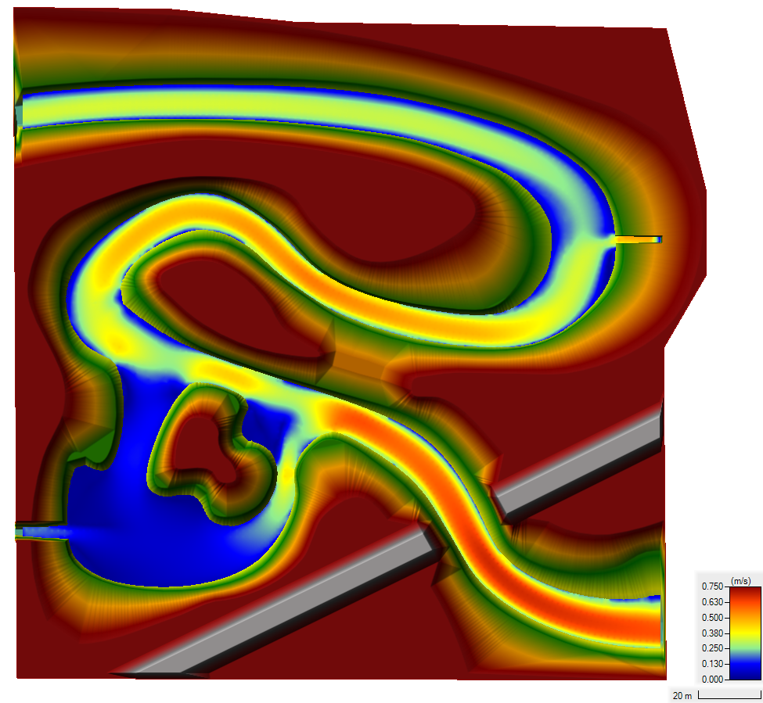
Demo Case Study: Sumwere Creek — Velocity at End of Simulation
Coarse Mesh Fine Mesh
Notes:
Differences in velocities between the meshes are due to varying spatial resolution in each mesh

Slide 17
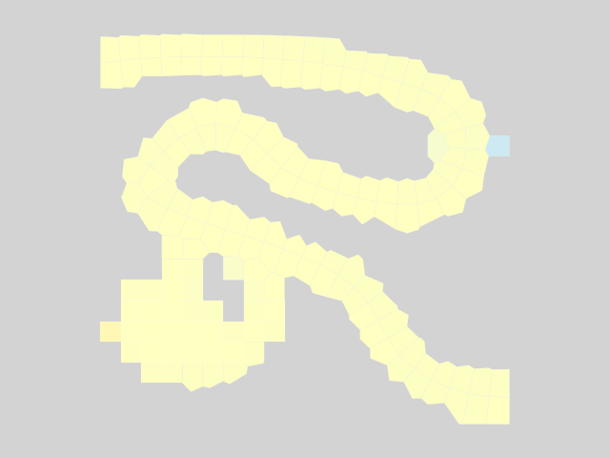
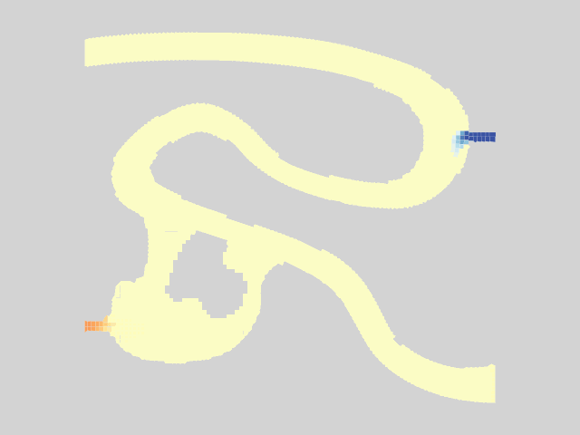
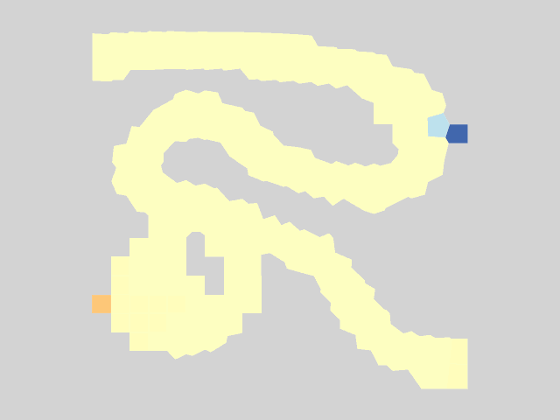
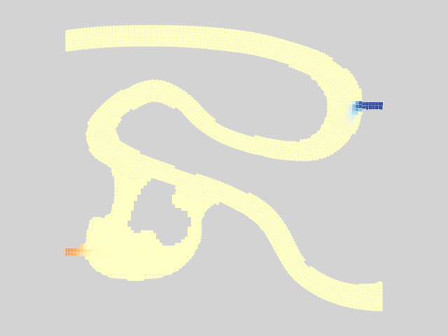
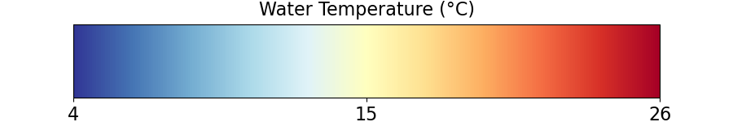
Results – Animation
Coarse Mesh Fine Mesh
Notes:
You can see the mixing.
Ultimately reaches steady state.

Slide 18
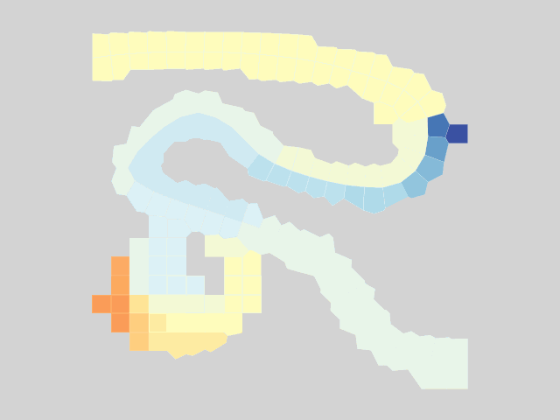
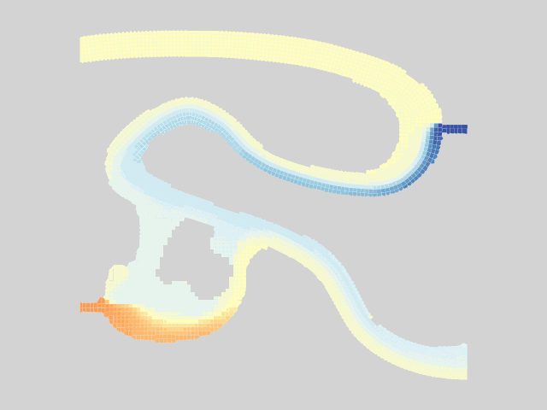

Results – Warm Powerplant Inflows
Coarse Mesh Fine Mesh
Notes:
Pulses from powerplant.
Can see a lot more transverse mixing from the powerplant and spring in the fine mesh compared to the coarse mesh.
Can see more detail on the plume of warm water.
This all shows transport very clearly, but what about our energy budget model / TSM?

Slide 19








Nutrient Modeling Capabilities
Dissolved Oxygen
Ammonia (NH₄)
Nitrate (NO₃)
Total Inorganic Phosphorus (TIP)
Notes:
Pulses from powerplant.
Can see a lot more transverse mixing from the powerplant and spring in the fine mesh compared to the coarse mesh.
Can see more detail on the plume of warm water.
This all shows transport very clearly, but what about our energy budget model / TSM?

Slide 20

ClearWater-Riverine Example: E. Coli Transport in the Ohio River

Slide 21

Benefits
Enables a seamless exchange of data and information between different components of an integrated modeling system.
Facilitates data-driven decision-making
Enhances collaboration between scientific disciplines
Integrated models that simulate the interactions between heat, nutrients, water flow, and vegetation enable a comprehensive representation of ecosystem dynamics.
Accurate representation of real-world processes
Enables assessment of the ecological responses to various environmental changes, such as land use modifications, climate change, or nature-based feature design and Best Management Practices (BMPs)
Example applications:
Setting nutrient loading limits
Designing buffer zones
Implementing BMPs to restore aquatic ecosystems

Slide 22

Water quality processes team
Over-riding objective:
Transform data to actionable information

Slide 23


Water quality processes team
Recent project topics:
Operational control dashboard for HABs
Historic water quality data analysis
Retrospective water quality data review
Post-wildfire water quality and ecology
Large scale nutrient transport in river systems
Networked riverine contaminant model
Fate and Risk Evaluation System for Contaminants
Global GIS for environmental terrain
New models for new data sources

Slide 24


Water quality processes team
Recent project topics:
Operational control dashboard for HABs
Historic water quality data analysis
Retrospective water quality data review
Post-wildfire water quality and ecology
Large scale nutrient transport in river systems
Networked riverine contaminant model
Fate and Risk Evaluation System for Contaminants
Global GIS for environmental terrain
Adding functionality to the archive

Slide 25



Water quality processes team
Recent project topics:
Operational control dashboard for HABs
Historic water quality data analysis
Retrospective water quality data review
Post-wildfire water quality and ecology
Large scale nutrient transport in river systems
Networked riverine contaminant model
Fate and Risk Evaluation System for Contaminants
Global GIS for environmental terrain
Standing back from operations to observe
long term patterns and trends

Slide 26



Water quality processes team
Recent project topics:
Operational control dashboard for HABs
Historic water quality data analysis
Retrospective water quality data review
Post-wildfire water quality and ecology
Large scale nutrient transport in river systems
Networked riverine contaminant model
Fate and Risk Evaluation System for Contaminants
Global GIS for environmental terrain
Untangling long- and short- term change
Gage 179 Pre- and Post- Fire Temps
Upper limit Chinook spawning
Upper limit Chinook egg viability
0 5 10 15
Temp, Deg-C
Upper limit Chinook alevin development
Week

Slide 27

Water quality processes team
Recent project topics:
Operational control dashboard for HABs
Historic water quality data analysis
Retrospective water quality data review
Post-wildfire water quality and ecology
Large scale nutrient transport in river systems
Networked riverine contaminant model
Fate and Risk Evaluation System for Contaminants
Global GIS for environmental terrain
Matching data to purpose

Slide 28





Water quality processes team
Recent project topics:
Operational control dashboard for HABs
Historic water quality data analysis
Retrospective water quality data review
Post-wildfire water quality and ecology
Large scale nutrient transport in river systems
Networked riverine contaminant model
Multimedia contaminant screening system
Global GIS for environmental terrain
Model and data systems built for science, not sensors
Contaminants:
Metals
Munitions
PFAS
Pesticides and toxins
Rare Earth Elements

Slide 29

















Team up on Water Quality and Contaminant Modeling Solutions
Programs and partners
USACE-ERDC-EL-EPW
Water Quality and Contaminant Modeling
Jodi L. Ryder
Jodi.L.Ryder@usace.army.mil
601-631-1852
Todd E. Steissberg
Todd.E.Steissberg@usace.army.mil
530-574-5572
Aaron C. Urbanczyk
Acting Chief EPW
Aaron.C.Urbanczyk@usace.army.mil
601-634-7408

